Slide 1
Ice Crystal Parameterizations in Arctic Cirrus – Towards a Better Representation in Global Climate Models and Aircraft Icing Potential Studies
Victoria A. Walker
Embry-Riddle Aeronautical University

Slide 2
Statement of Purpose
Study the microphysical properties of arctic cirrus
Investigate possible correlations between aircraft icing and ice crystal SDs

Slide 3
Cirrus and Global Climate Models (GCMs)
Cirrus feedbacks affect model output of T, radiative forcing, albedo, and heat flux.
Cloud properties a function of IWC and SDs.
  Radiative properties depend on T and SDs.
Not thoroughly studied at high latitudes.

Slide 4
Aircraft Icing: Ice- and Mixed- Phase Clouds
FAA certifies clouds containing only SLDs.
Canadian Freezing Drizzle Experiment (CFDE)
  Non-classically formed SLDs ~ 80%
  Ice- or mixed-phase clouds ~ 50%
Non-classically formed SLDs have not been thoroughly studied.

Slide 5
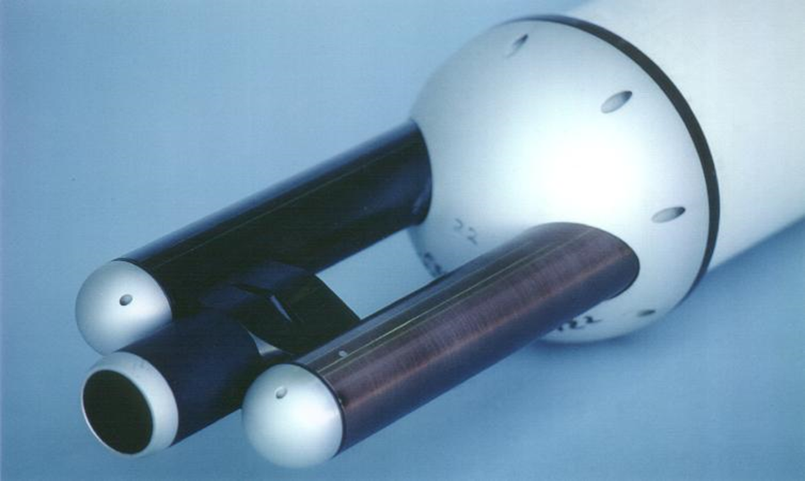
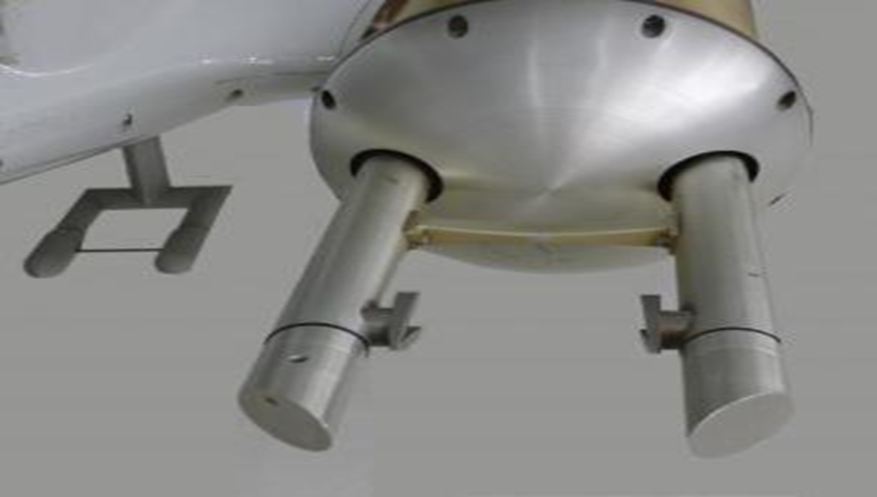
Optical Sampling Instruments:
FSSP (left) and 2DC (right)

Slide 6
DoE – ARM Research Flights
Oliktok Mobile Operations Base
3 Flights: 30 Oct 13, 3 Nov 13, 7 Nov 13
Flight 1 | Flight II | Flight III
666 | 366 | 210
After Criteria for Statistical Relevance [5 small mode, 4 large mode]
533 | 320 | 161

Slide 7
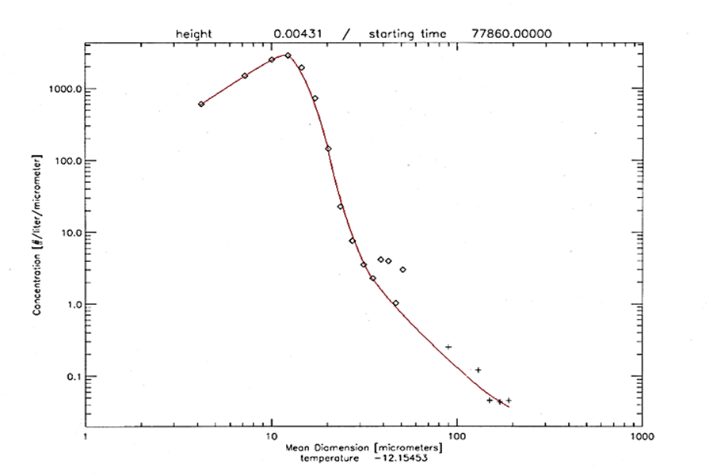
Gamma Distribution: N_{o}, λ, v
 | N_{o} | λ | v
Average | 1.65 | 3.89 | 2.84
Flight 1 | 1.25 | 3.76 | 2.33
Flight 2 | 1.85 | 3.96 | 2.91
Flight 3 | 1.73 | 3.85 | 2.90

Slide 8
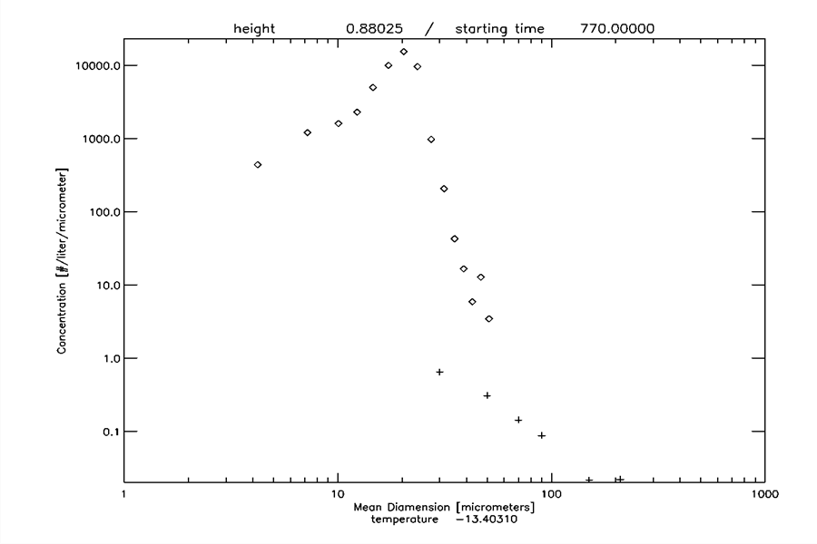
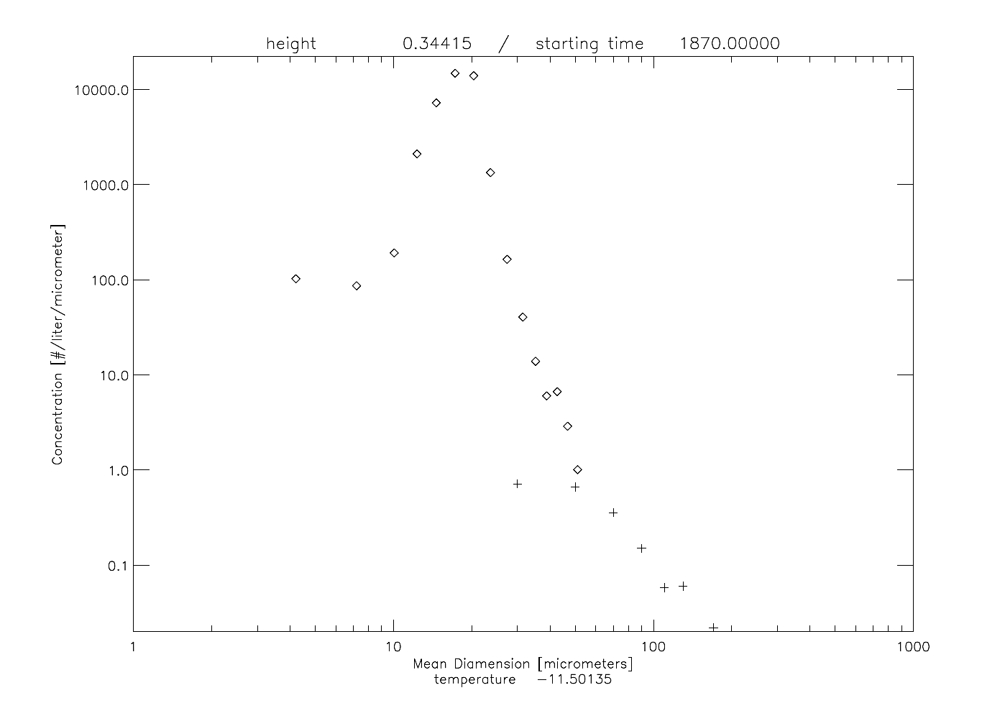
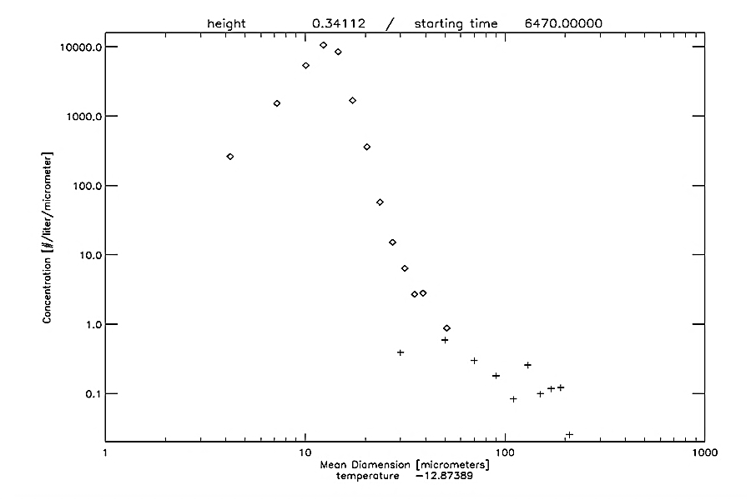
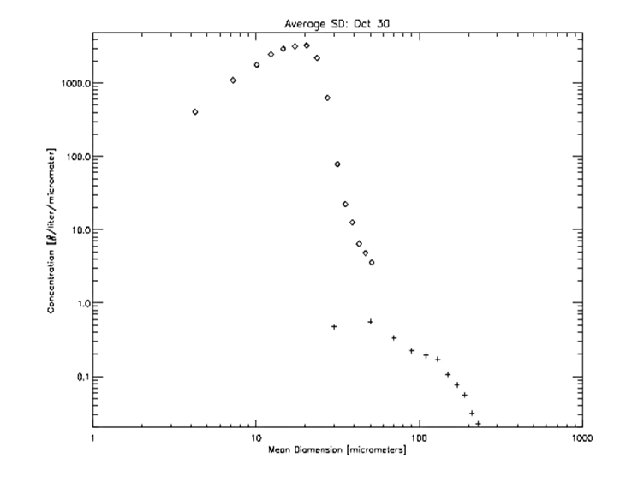

Slide 9
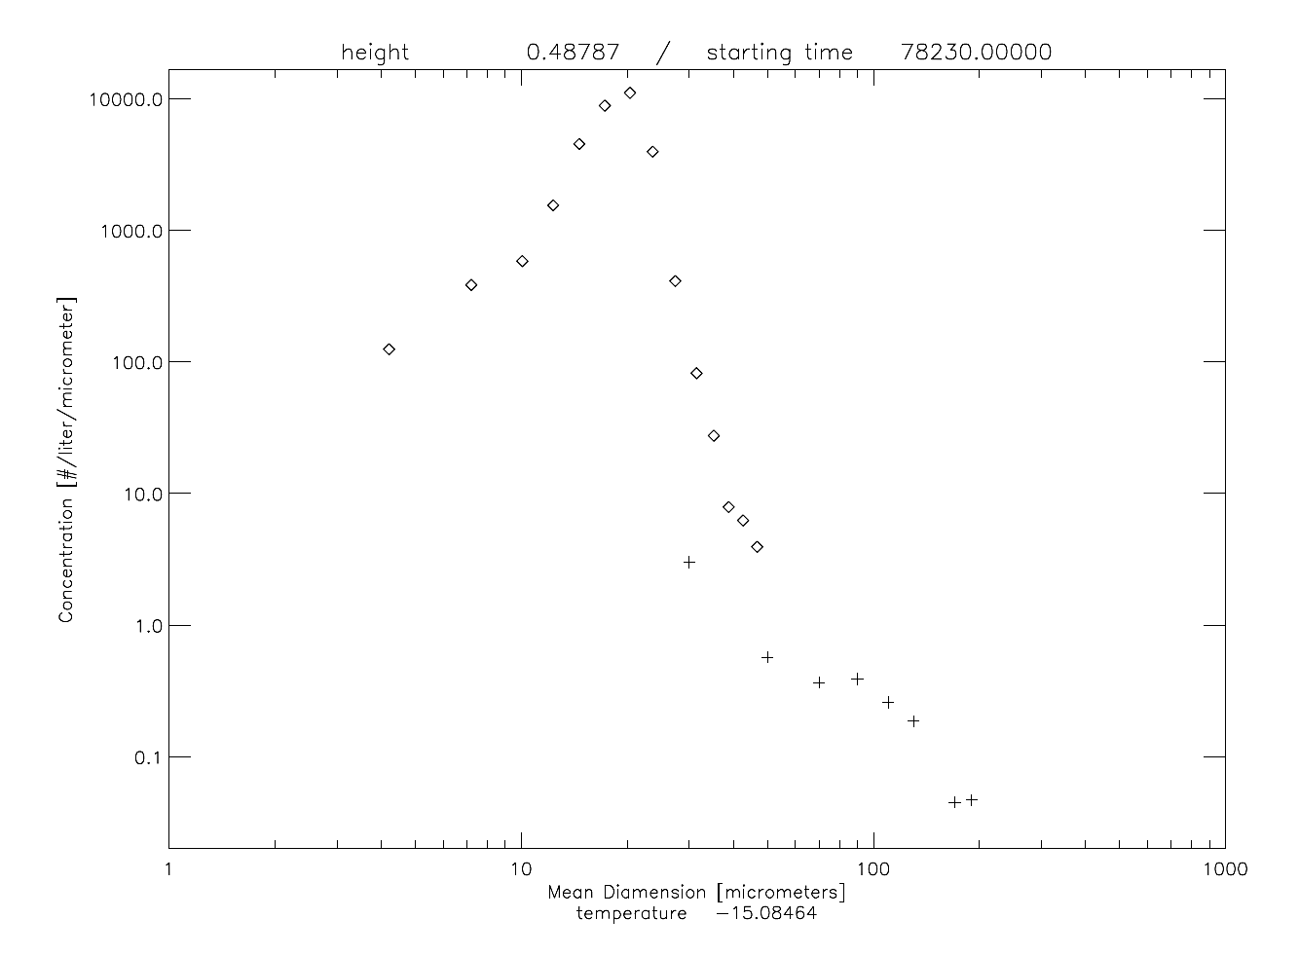
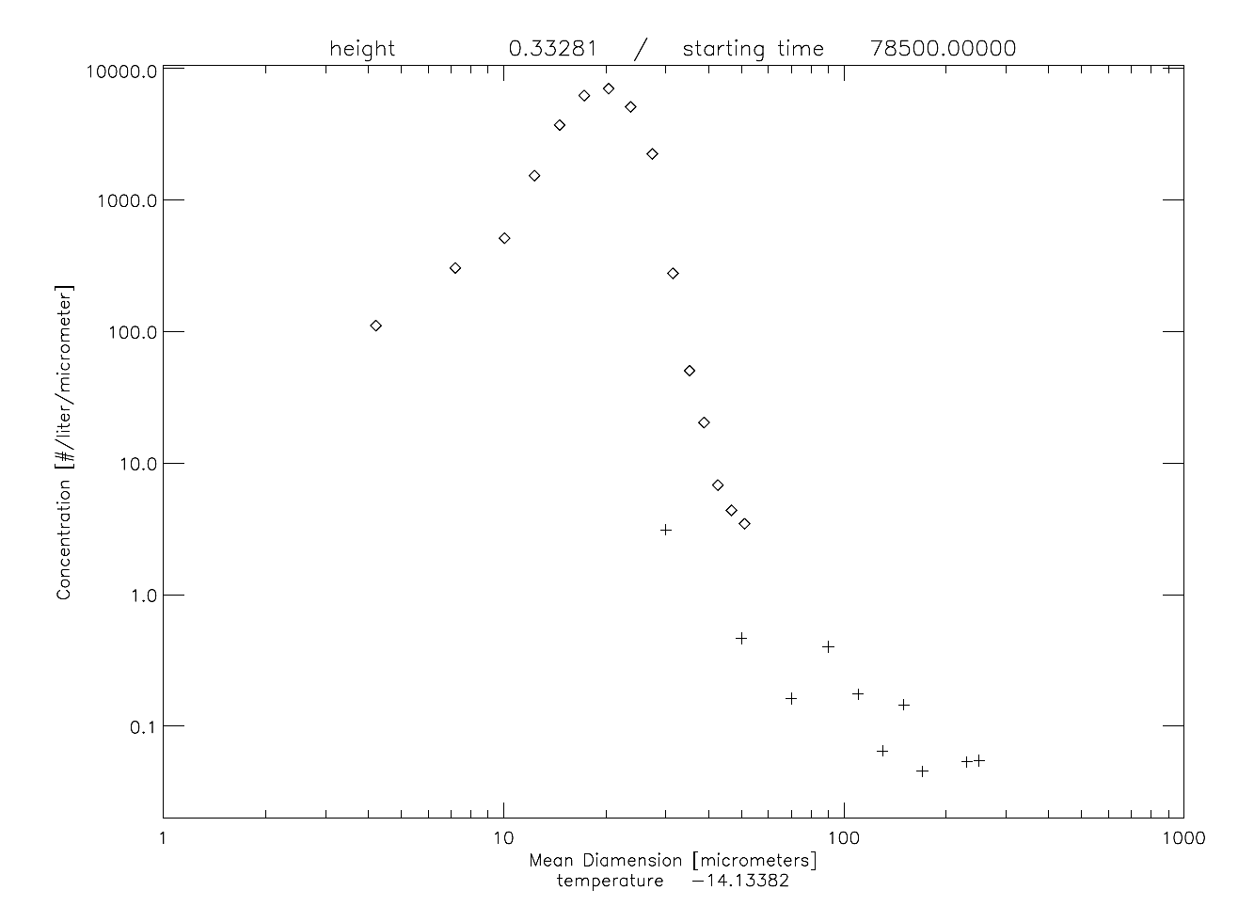
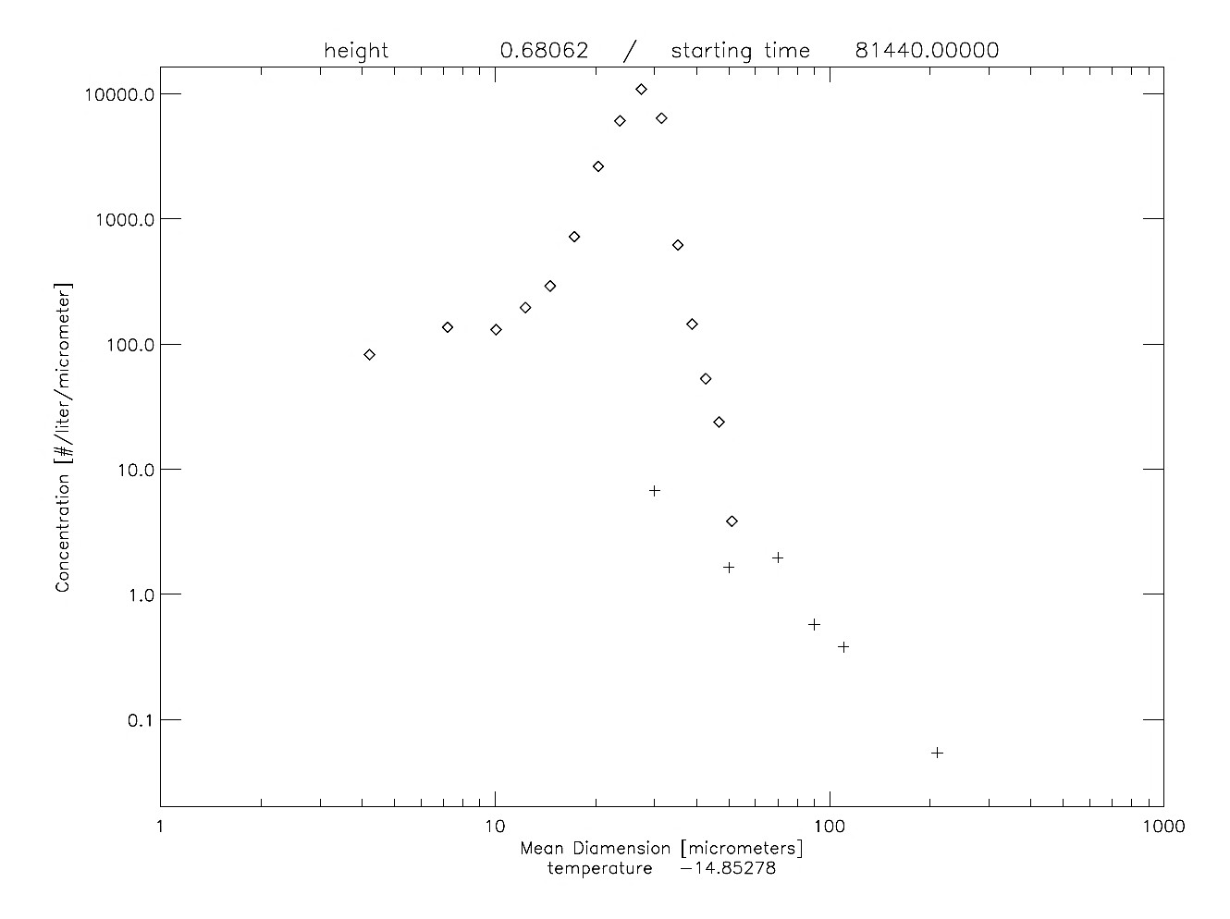
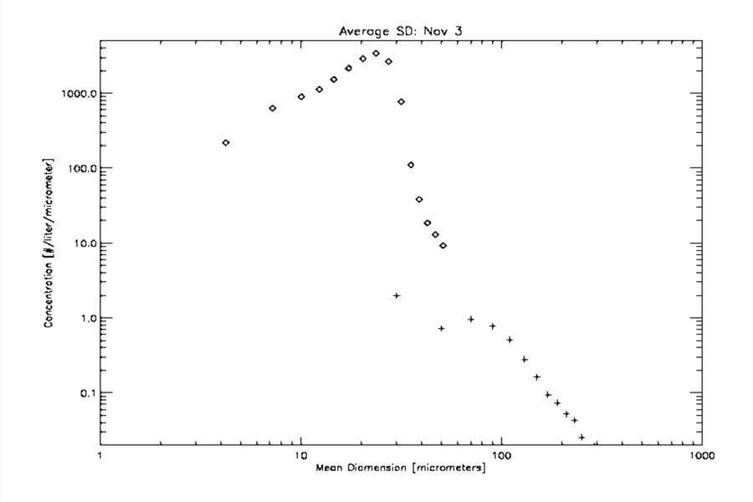

Slide 10
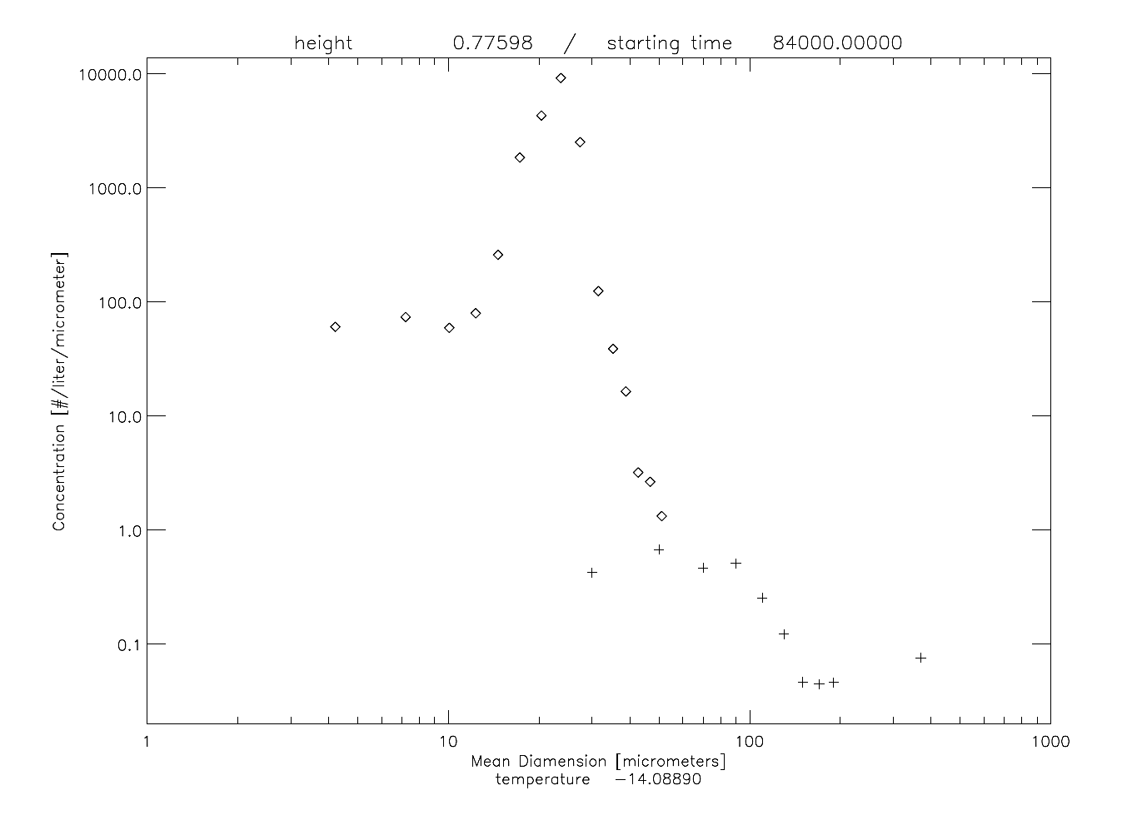
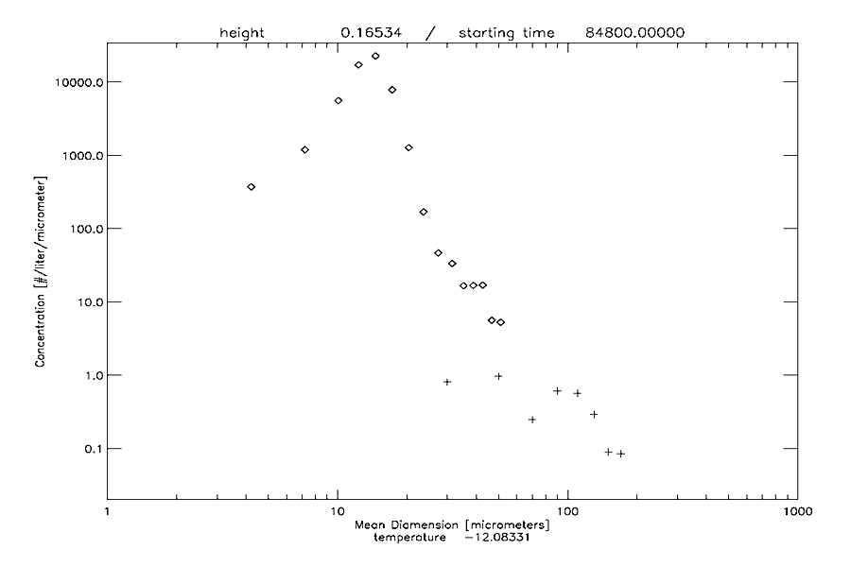
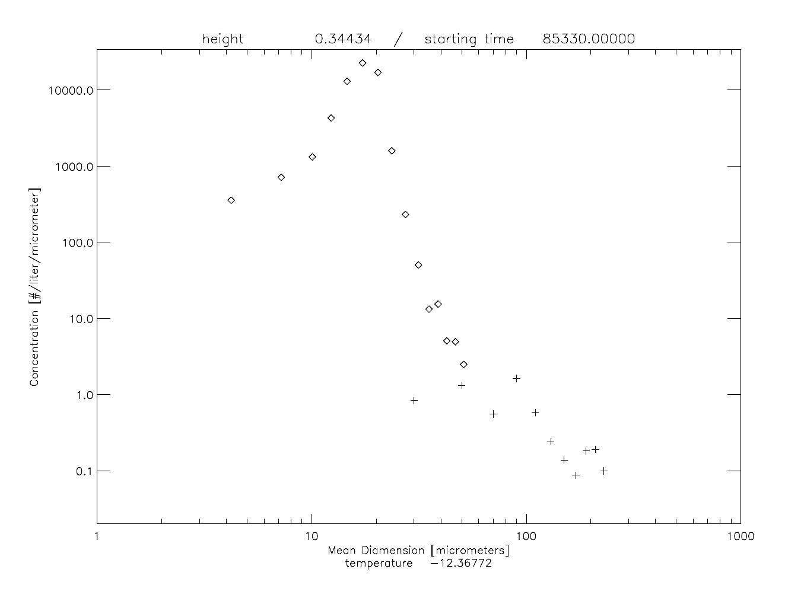
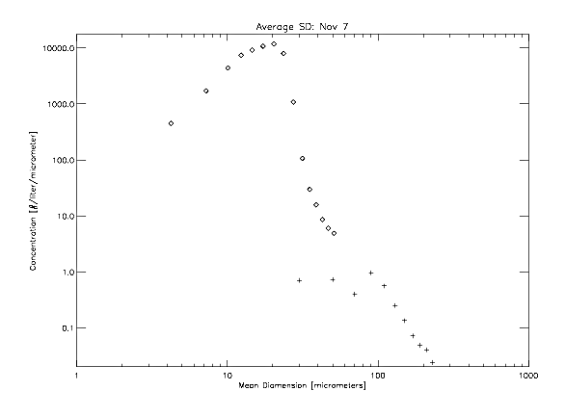

Slide 11
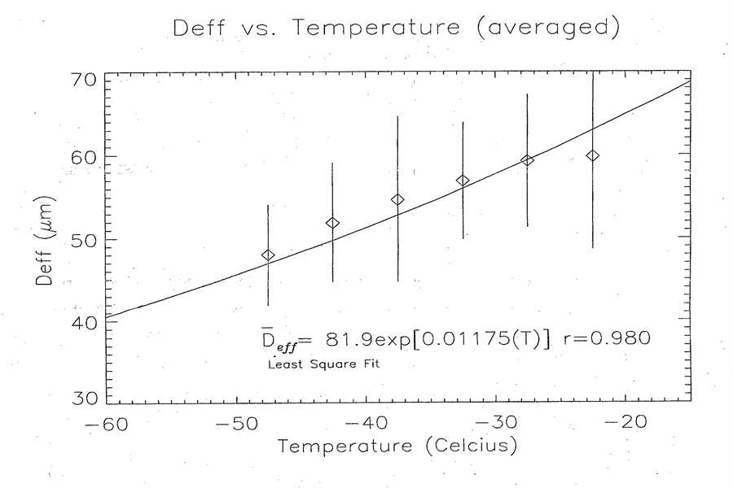
Arctic Cirrus – Variation with T

Slide 12
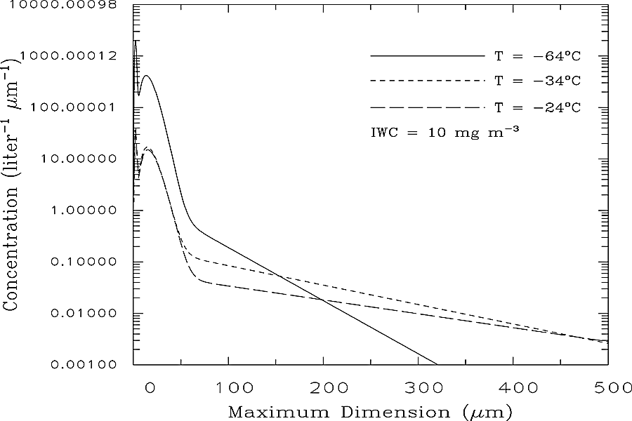
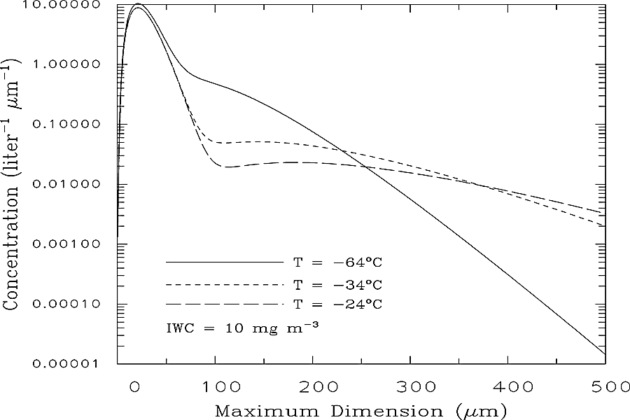
SD Variation with T: Tropical (left) and Mid-Latitude (right)

Slide 13
Implications for Aircraft Icing
Aircraft icing during aggregation, accretion, and mixed-accretion events must be the focus of further study.
Particle interactions with aircraft, such as collapse, erosion, and structural breakup upon impact, should be thoroughly investigated.

Slide 14
Conclusions
Arctic dataset is monomodal compared to tropical and mid-latitude datasets.
  Points to formation mechanisms at various latitudes.
Arctic cirrus may be linked to non-classical formation of SLDs.
Aircraft icing certification can only be achieved through an understanding of both ice- and mixed-phase cloud microphysics.

Slide 15
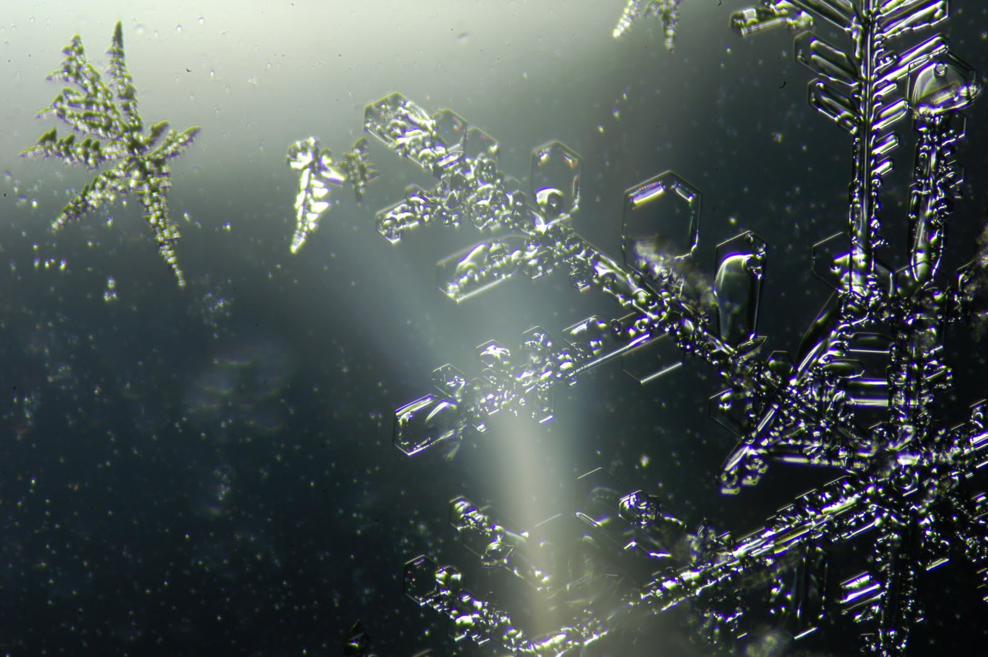
Questions?
Image courtesy of http://onthickice.blogspot.com/

Slide 16
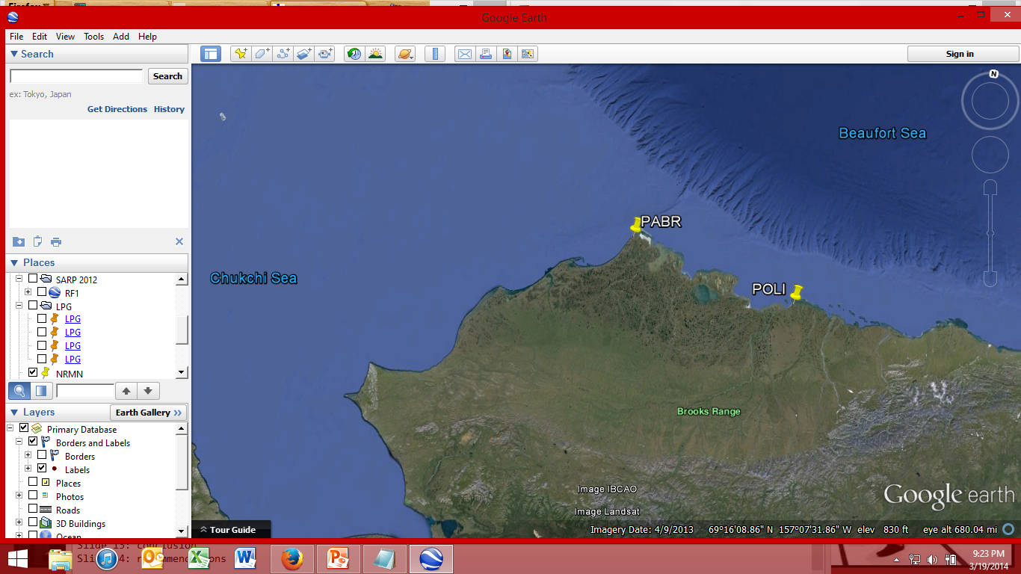

Slide 17
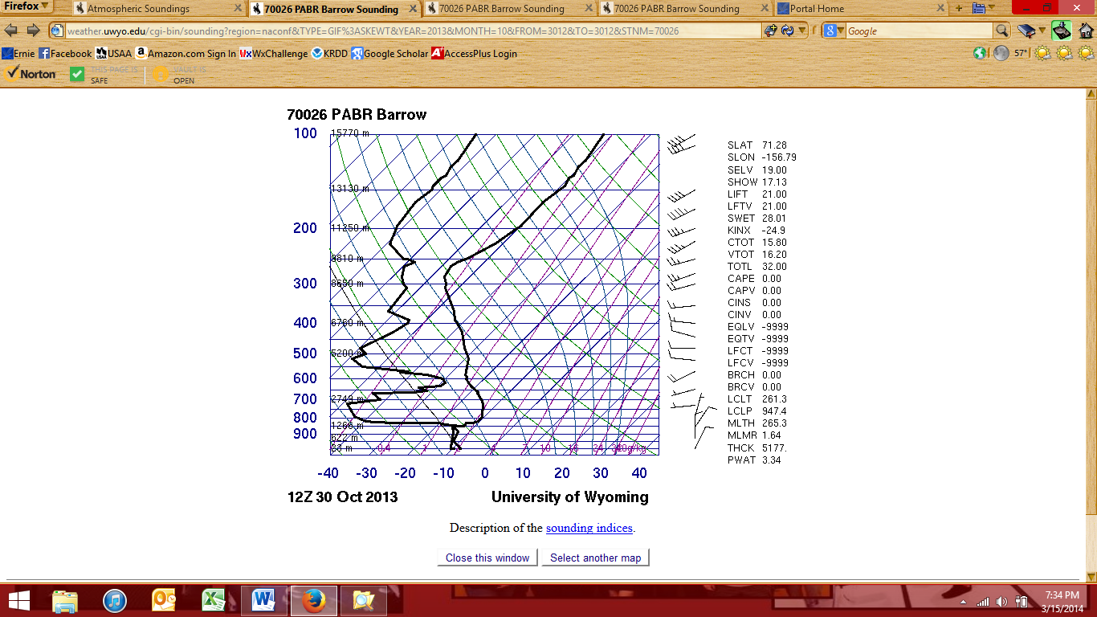
Flight I: Synoptic Situation

Slide 18
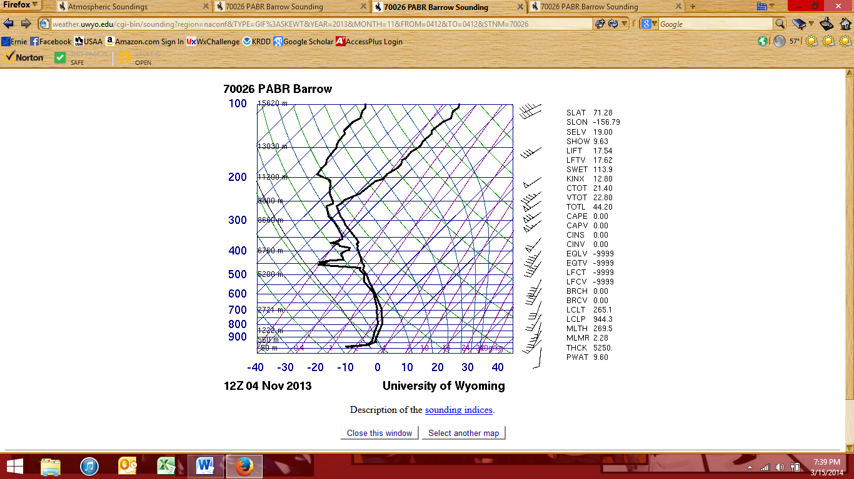
Flight II: Synoptic Situation

Slide 19
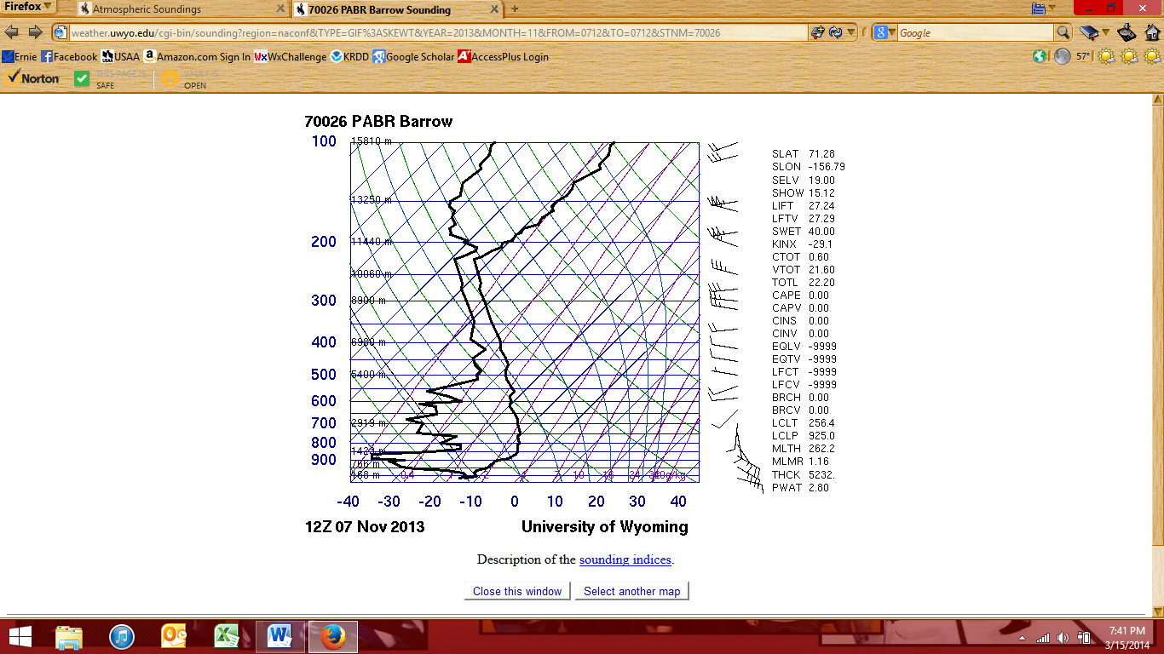
Flight III: Synoptic Situation

Slide 20
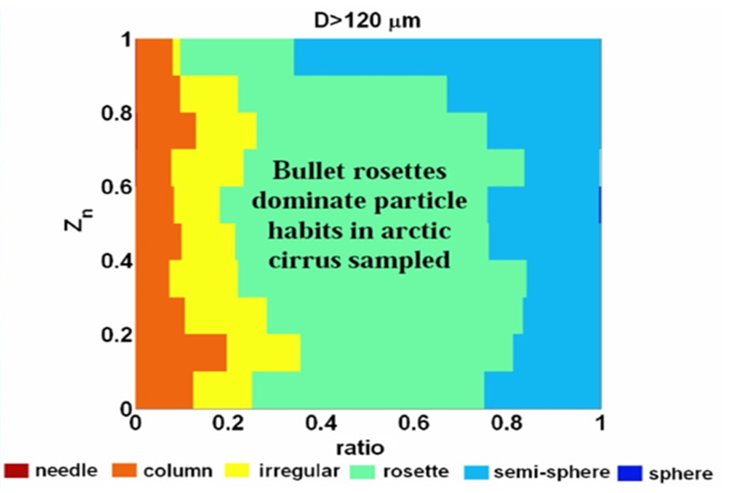
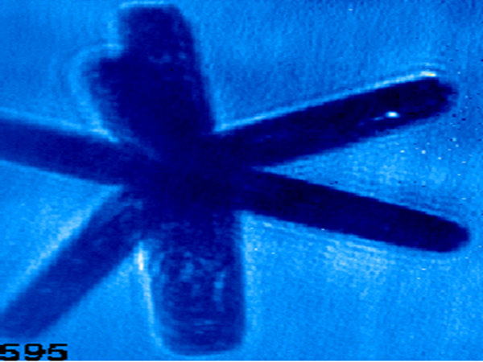
Formation Habits – Aspect Ratio

